Slide 1
Data Mining
By . Mohamed Aobh

Slide 2

Background
Definitions
Data warehouse
Common tasks
Data mining elements
Analysis Levels.

Slide 3
Background
Humans have been "manually" extracting information from data for centuries, but the increasing volumes of data in modern times has called for more automatic approaches.
Data sets and the information extracted from them have grown in size and complexity.

Slide 4
Direct hands-on data analysis has increasingly been supplemented and augmented with indirect, automatic data processing using more complex and sophisticated tools, methods and models.
Data mining is the process of using computing power to apply methodologies, including new techniques of knowledge discovery to data.

Slide 5
Data
Data are any facts, numbers, or text that can be processed by a computer.
Today, organizations are accumulating vast and growing amounts of data in different formats and different databases.
This includes:

Slide 6
Operational or transactional data such as, sales, cost, inventory, payroll, and accounting
Non-operational data, such as industry data, forecast data, and macro economic data
Meta- data - data about the data itself, such as data dictionary definitions.

Slide 7
Relational & Multidimensional database structure
A hotly debated technical issue is whether it is better to set up a relational database structure or a multidimensional one.
In a relational structure, data is stored in tables, permitting ad hoc queries.
In a multidimensional structure, on the other hand, sets of cubes are arranged in arrays, with subsets created according to category.

Slide 8
Information
The patterns, associations, or relationships among all this data can provide information.
Information can be converted into knowledge about historical patterns and future trends.
Knowledge

Slide 9
Data Mining
Definitions
Data warehouse
Common tasks
Data Mining Elements
Analysis Levels.

Slide 10
Data Mining
Data mining is the process of extracting hidden patterns from data.
As more data is gathered, with the amount of data doubling every three years (?), data mining is becoming an increasingly important tool to transform this data into information.

Slide 11
It is commonly used in a wide range of applications, such as marketing, fraud detection and scientific discovery.
Data mining can be applied to data sets of any size.

Slide 12
Data mining (sometimes called data or knowledge discovery) is the process of analyzing data from different perspectives and summarizing it into useful information
Information that can be used to increase revenue, cuts costs, or both.
The data analysis software is what supports data mining.

Slide 13
Data Warehouses
Data warehousing is defined as a process of centralized data management and retrieval.
Data warehousing represents an ideal vision of maintaining a central repository (storing) of all organizational data.
Centralization of data is needed to maximize user access and analysis.

Slide 14
Data Mining Tasks
Classification
Clustering
Association Rule Discovery
Sequential Pattern Discovery
Regression

Slide 15
Data Mining is commonly used to perform four classes of tasks :
Classification
  Arranges the data into predefined groups. For example an email program might attempt to classify an email as legitimate or spam.
  Common algorithms include Nearest neighbour, and Neural network.

Slide 16
Clustering :
  Is like classification but the groups are not predefined, so the algorithm will try to group similar items together.

Slide 17
Association :
  Searches for relationships between variables. For example a supermarket might gather data of what each customer buys.
  Using association rule learning, the supermarket can work out what products are frequently brought together, which is useful for marketing purposes.
  This is sometimes referred to as "market basket analysis".

Slide 18
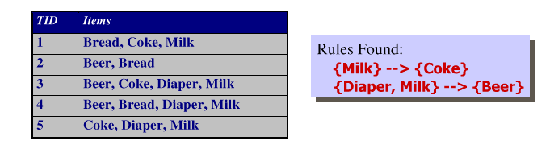
Association Rule Discovery
Given a set of records, each of which contain some number of items from a given collection
  produce dependency rules which will predict occurrence of an item based on occurrences of other items

Slide 19
Regression :
  Attempts to find a function which models the data with the least error.
  A common method is to use Genetic Programming.

Slide 20
Visualization
complement to other DM techniques like Segmentation, … etc.

Slide 21
Data Mining Elements
Data mining consists of five major elements:
Extract, transform, and load transaction data onto the data warehouse system.
Store and manage the data in a multidimensional database system.
Provide data access to business analysts and information technology professionals.
Analyze the data by application software.
Present the data in a useful format, such as a graph or table.

Slide 22
Analysis Levels
Different levels of analysis are available:
Artificial neural networks:
Non-linear predictive models that learn through training and resemble (imitate) biological neural networks in structure.
Genetic algorithms:
Optimization techniques that use processes such as genetic combination, mutation (change), and natural selection in a design based on the concepts of natural evolution.

Slide 23
Decision trees:
  Tree-shaped structures that represent sets of decisions.
  These decisions generate rules for the classification of a data set.
Rule induction: The extraction of useful if-then rules from data based on statistical significance.
Data visualization: The visual interpretation of complex relationships in multidimensional data.
(Graphics tools are used to illustrate data relationships.)

Slide 24
KDD Process
Data Mining Process

Slide 25
KDD Vs Data Mining
Data Mining is popularly known as Knowledge Discovery in Database (KDD).
Data mining is actually part of KDD process.
Data Mining is the Core of KDD

Slide 26
Knowledge Discovery in Databases (KDD): process of finding useful information and patterns in data.
Data Mining: Use of algorithms to extract the information and patterns derived by the KDD process.

Slide 27
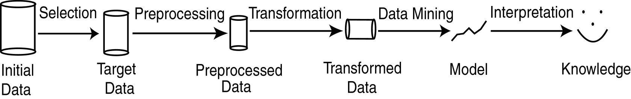
KDD Process
Classification, clustering, Association, etc…

Slide 28
Selection: Obtain data from various sources.
Preprocessing: data cleaning.
Transformation: Convert to common format. Transform to new format.
Data Mining: Obtain desired results by applying Data Mining tasks tools.
Interpretation/Evaluation: Present results to user in meaningful manner.

